Slide 1
The Bridge
Consultant Profile & New Hire Bio

Slide 2
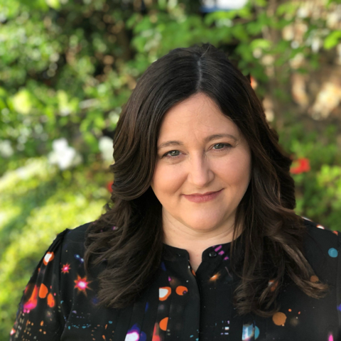
Kelly Wood Vice President — Salesforce
Email
kelly.wood@thebridge.com
Location
DFW, Texas
Mobile
(817) 703-7636
Kelly joined The Bridge in August 2024. She has over 14 years of experience in the Salesforce ecosystem and has spent the last 12 partnering with clients to deliver scalable, transformative solutions. She has experience across multiple industries, from tech startups to global enterprises.
EXPERIENCE
Industry Experience
Financial Services | Technology | Airline | Logistics | Manufacturing
Customer Self-Service Portal | Airline
Led team of 28 consultants to design and develop self-service customer portal for corporate travel managers and travel management company users.
Multi-year phased project focused on providing industry leading solutions for the airline’s customers.
Solution technologies:
Sales Cloud
Experience Cloud
AWS
Tableau
Enterprise Salesforce Implementation | Shipping Logistics
Served as Architect and team lead for implementation of Salesforce to support sales, customer service, back-office operations and franchise management. Implementation included multiple integrations to provide single pane of glass experiences for employees, customers, and partners.
Led team of 6 Salesforce developers and administrators over two-year program to implement solutions for multiple business units
Established Salesforce DevOps process and created best practices for team.
Standardized custom processes across lines of business
Solution technologies:
Sales Cloud
Service Cloud
Experience Cloud (Customer & Partner)
MuleSoft
BACKGROUND
Functional Skills
Process Design & Automation, Solution & Technical Architecture, business analysis, Salesforce Administration & Development, Digital Transformation
Qualifications
Consulting leader focused s with strong functional and technical skills. Kelly is passionate about leveraging the Salesforce platform to create meaningful customer experiences, grow revenue, and improve operational efficiencies.

